Slide 1

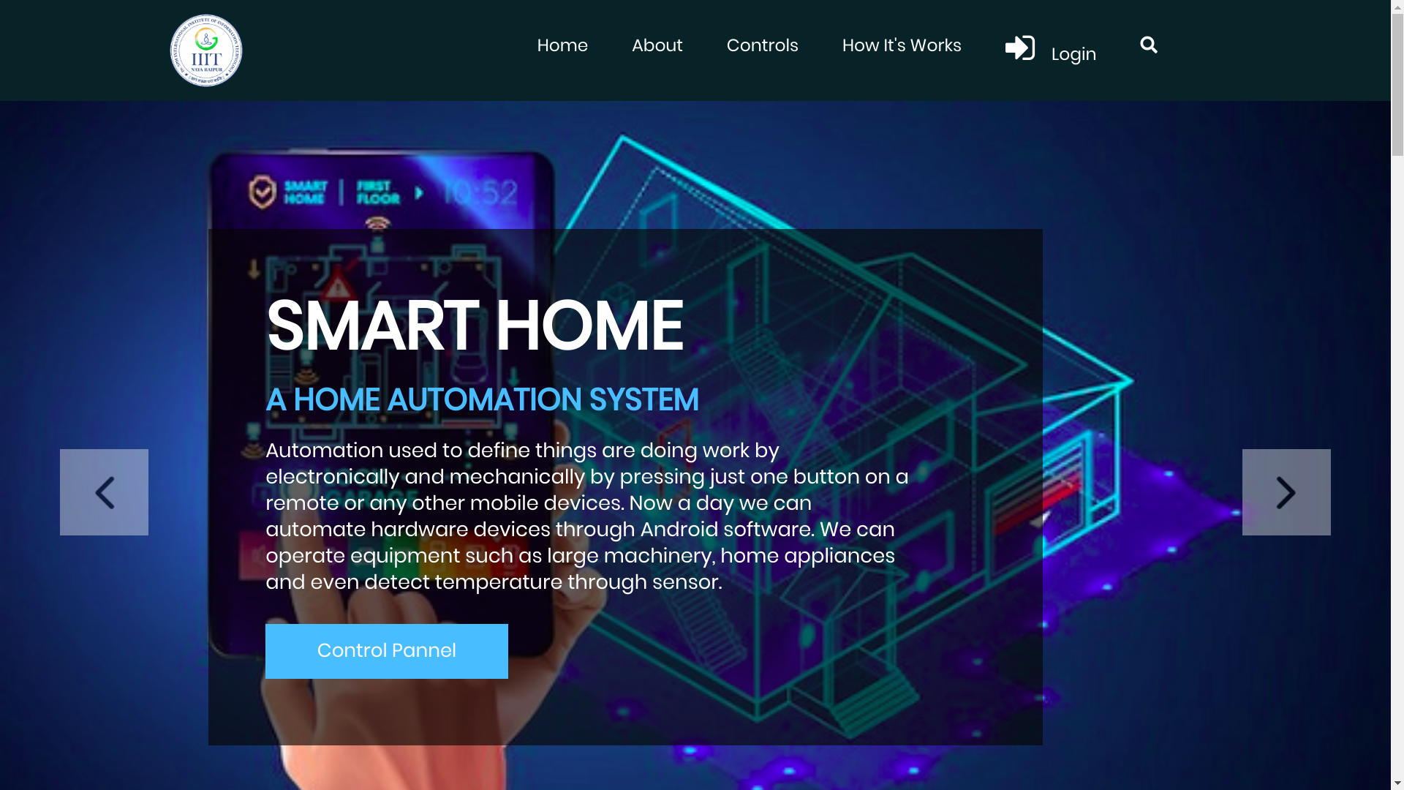

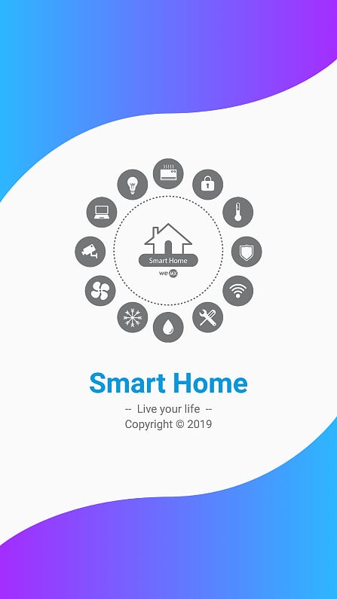
Minor Project - VI Sem
Home Automation with Security Surveillance
-Home on your fingers
Guided By :-
Dr. Muneendra Ojha

Slide 2
Our Team
Saurabh Roy | 17100050
Saurabh Pandey | 17100049
Himanshu Khairajani | 17100017

Slide 3
Outline
Introduction
Software model
Technologies used
Use-Case
Description
Solution proposal
Salient features
Setup and Working
Application and Conclusion

Slide 4




Introduction
In today’s world where technology is an integral part of our lives, we don’t want to lag behind in the fields of security and automation of our home.
Home automation and security is a must-have technology these days as it provides:
Convenience and comfort (especially for working class and old people)
Security
Water and energy savings
Control home appliances via voice/taps.
Remotely control your home when away.

Slide 5
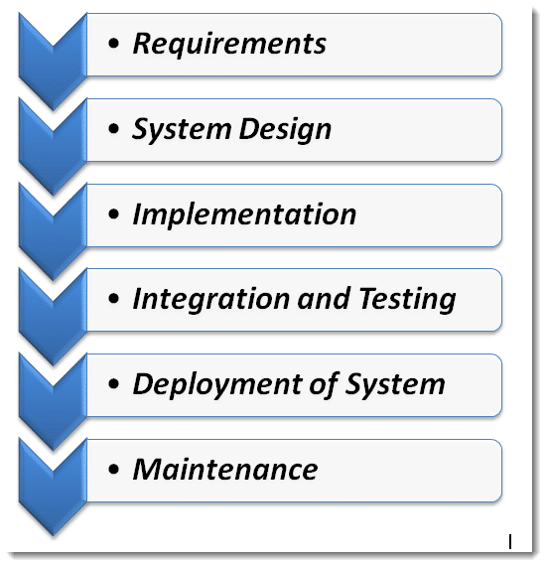
Software development model - Waterfall
Waterfall model was opted t make this project.
It Made easy to first gather all the resources and plans required for this project.
Then carrying out the proposed model in respective order..
And finally implementing the software with testing and maintenance made it successfully

Slide 6








Technologies Used

Slide 7
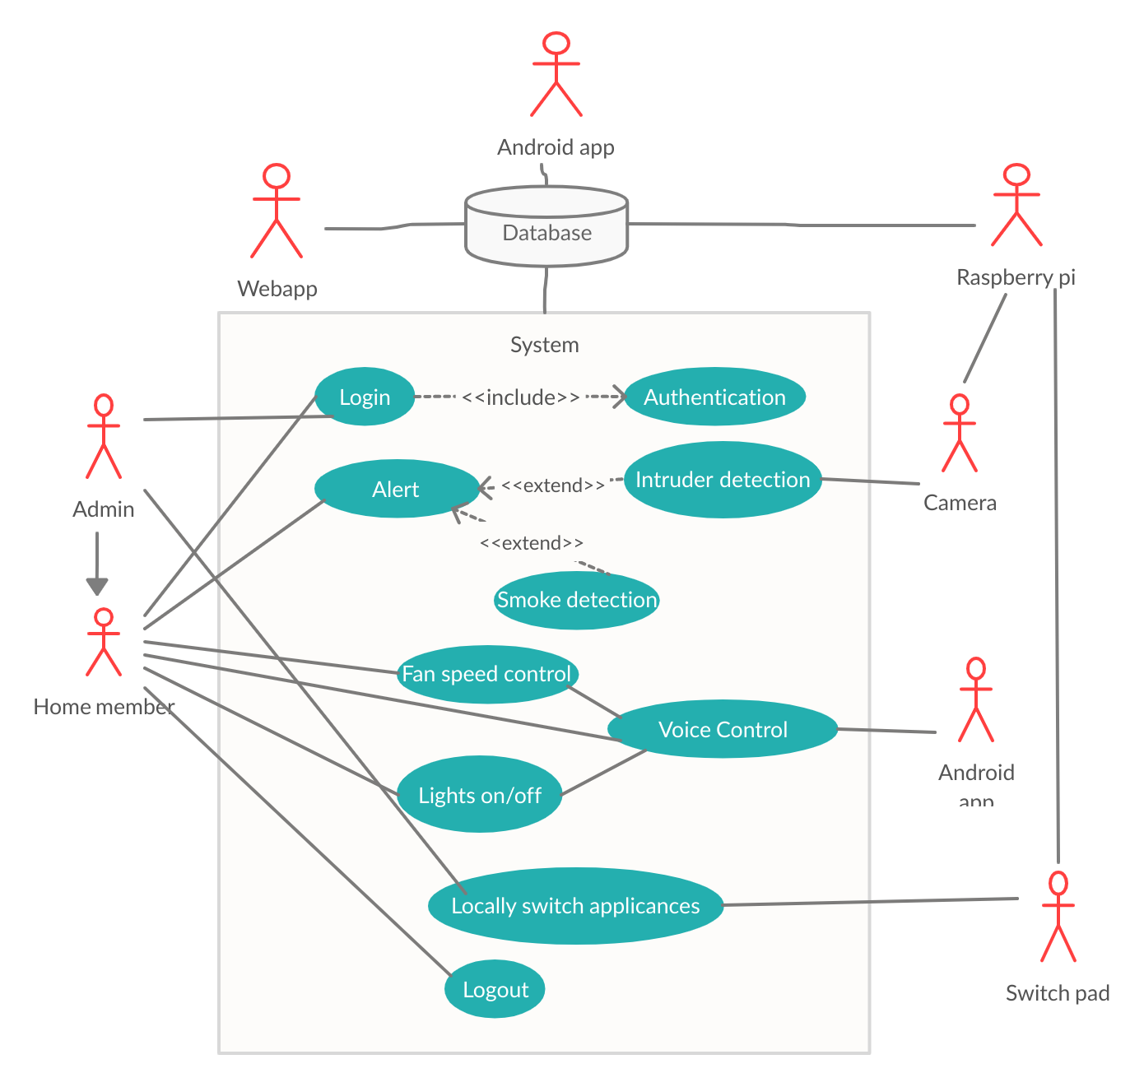
Use-case
Dependencies
Android 5.0 or higher
OpenCV
Dlib
Key Features
Controlling home appliances via mobile or web interface for labour-saving.
Security alert to detect intrusion, gas leakage and fire.
IoT based door locking system (future integration).
Efficient energy conservation.

Slide 8
Description of Solution
Technology Stack
Android Studio
HTML5, CSS3, Bootstrap, Javascript
Python
Django
Firebase
Raspberry pi
Camera
Relay board
Sensors
A mobile and web user friendly interface for controlling the system.
After sign-up, the user can login and use the automation system with credentials if the admin (an authorised person defined during system deployment) permits him/her.
Admin can control the automation system as well as grant and revoke access from the signed-up users.
Authenticated user can control appliances (fan, bulb, door-lock, camera) via a switch or toggle button. For example, a switch to turn ON/OFF the bulb, and a toggle button to regulate the fan speed and so on.
User also has an option to control the system using voice commands.
A surveillance system.
Camera surveillance
Camera is taking frames and detecting any face in the frame.
It is applying face recognition and in case of any UNKNOWN face it is sending an alert to user for intruder
Offline access
In case of no internet connection, the user can easily control using the built-in mechanical switches.
The switch is also synched to the database in case the internet is connected.
Alert system
Automatic door locking to burglar-proof the house.
Alert to prevent from fire, gas, energy and water leakage.

Slide 9
Salient Features
Admin can give or revoke access of members.
Dual accessibility of appliances using local switches and androids remotely.
Remote accessibility from web as well as mobile apps.
Synchronization of appliances states across multiple devices.
Home surveillance using face recognition.

Slide 10
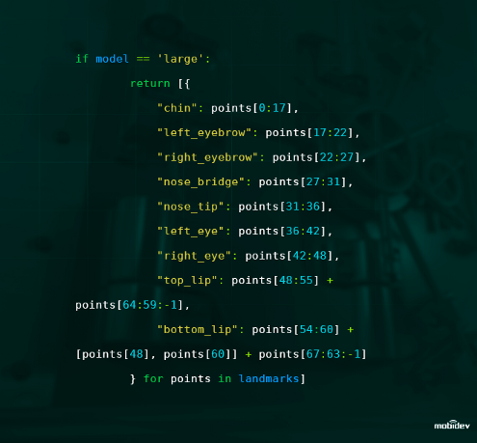
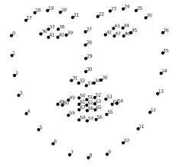
Facial Recognition

Slide 11
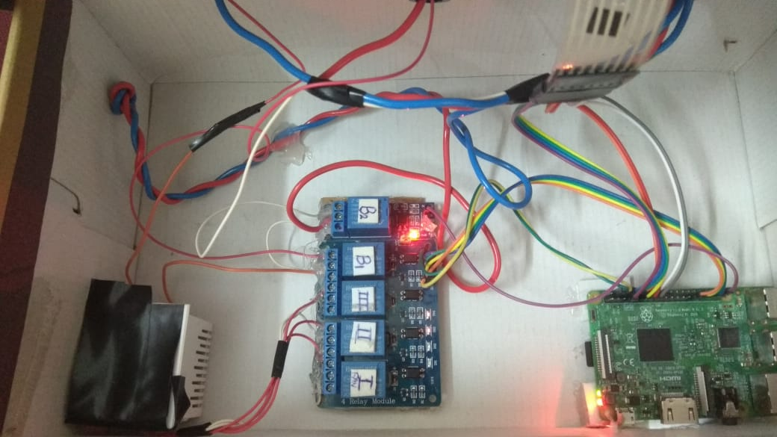
Hardware setup

Slide 12
Working?
-- Easy as pie --

Slide 13
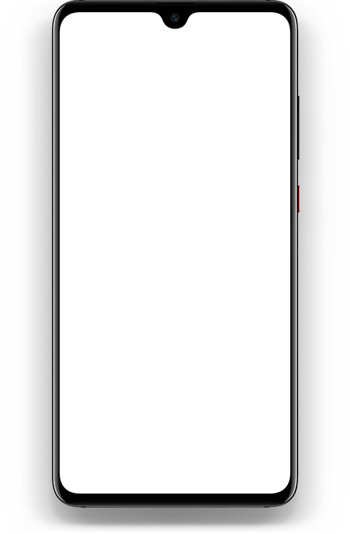
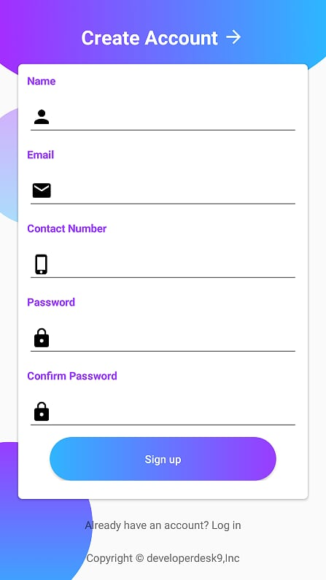
Create an account for members
Provide your email and create a password.
Fill name and phone number.
Wait for email verification by admin.
You are all set to go

Slide 14
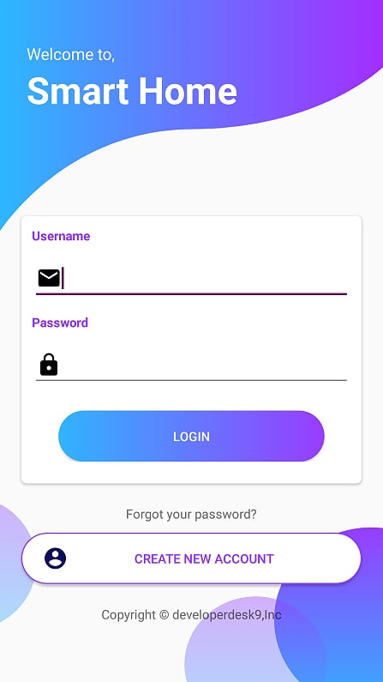
2. Login to your account
Enter you email and password.
Just tap on the login button.
Click on “Create new account” to create a new account

Slide 15
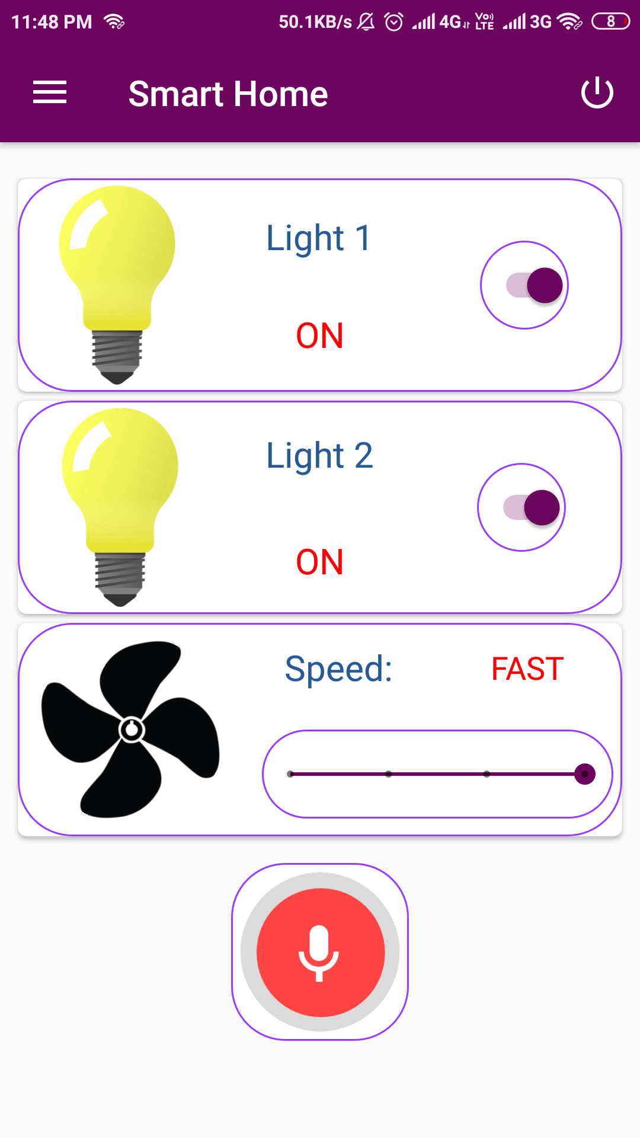
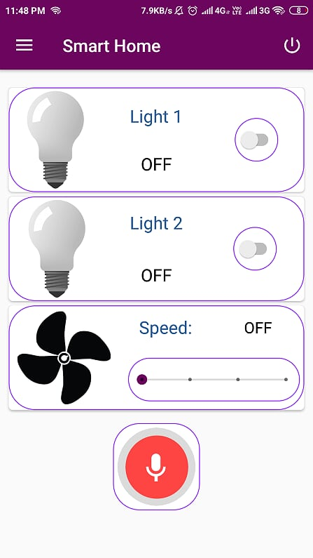
3. And the fun begins...
For now we have 3 appliances
Tap on the bulb to turn it off or on.
Control the speed of the fan by adjusting the slider.
Click on top right “logout” button to log out.

Slide 16
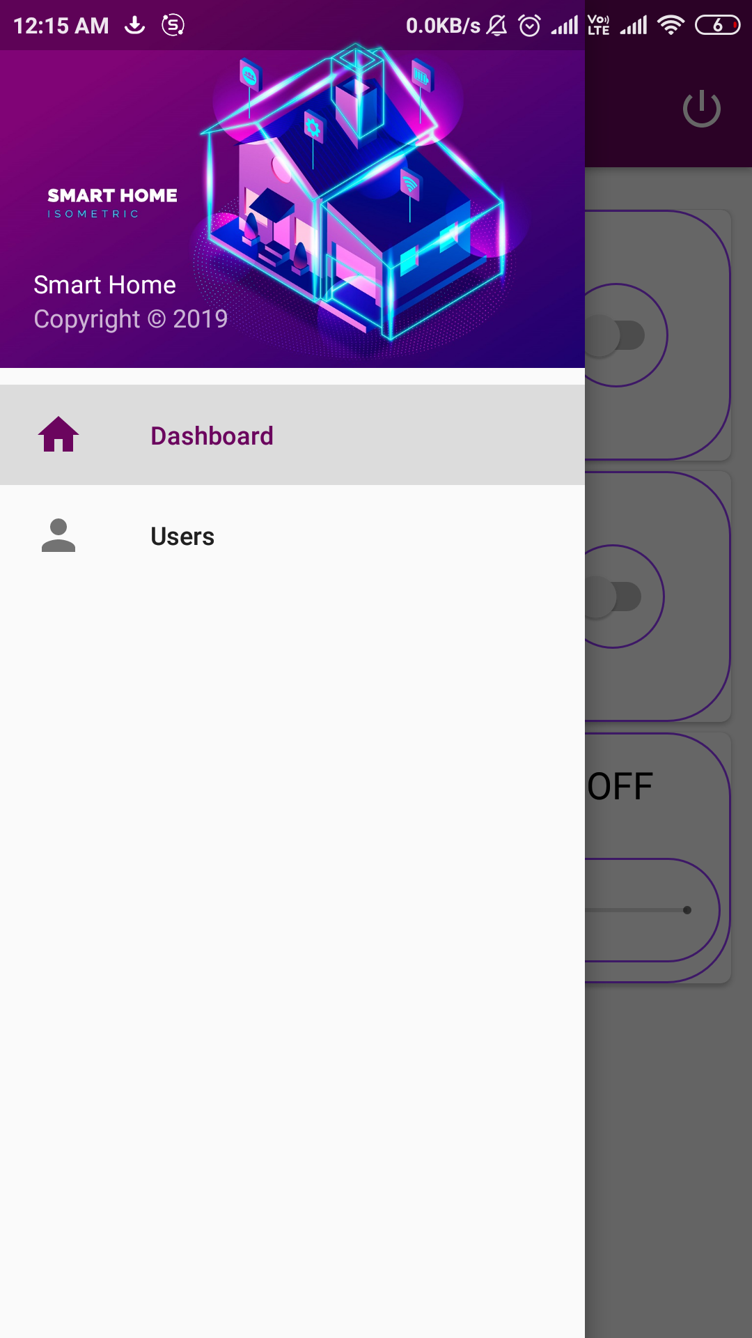
4. Navigation
Admin can navigate between Dashboard and managing Users.
Dashboard for accessing appliances and Users for setting permission for other users.

Slide 17
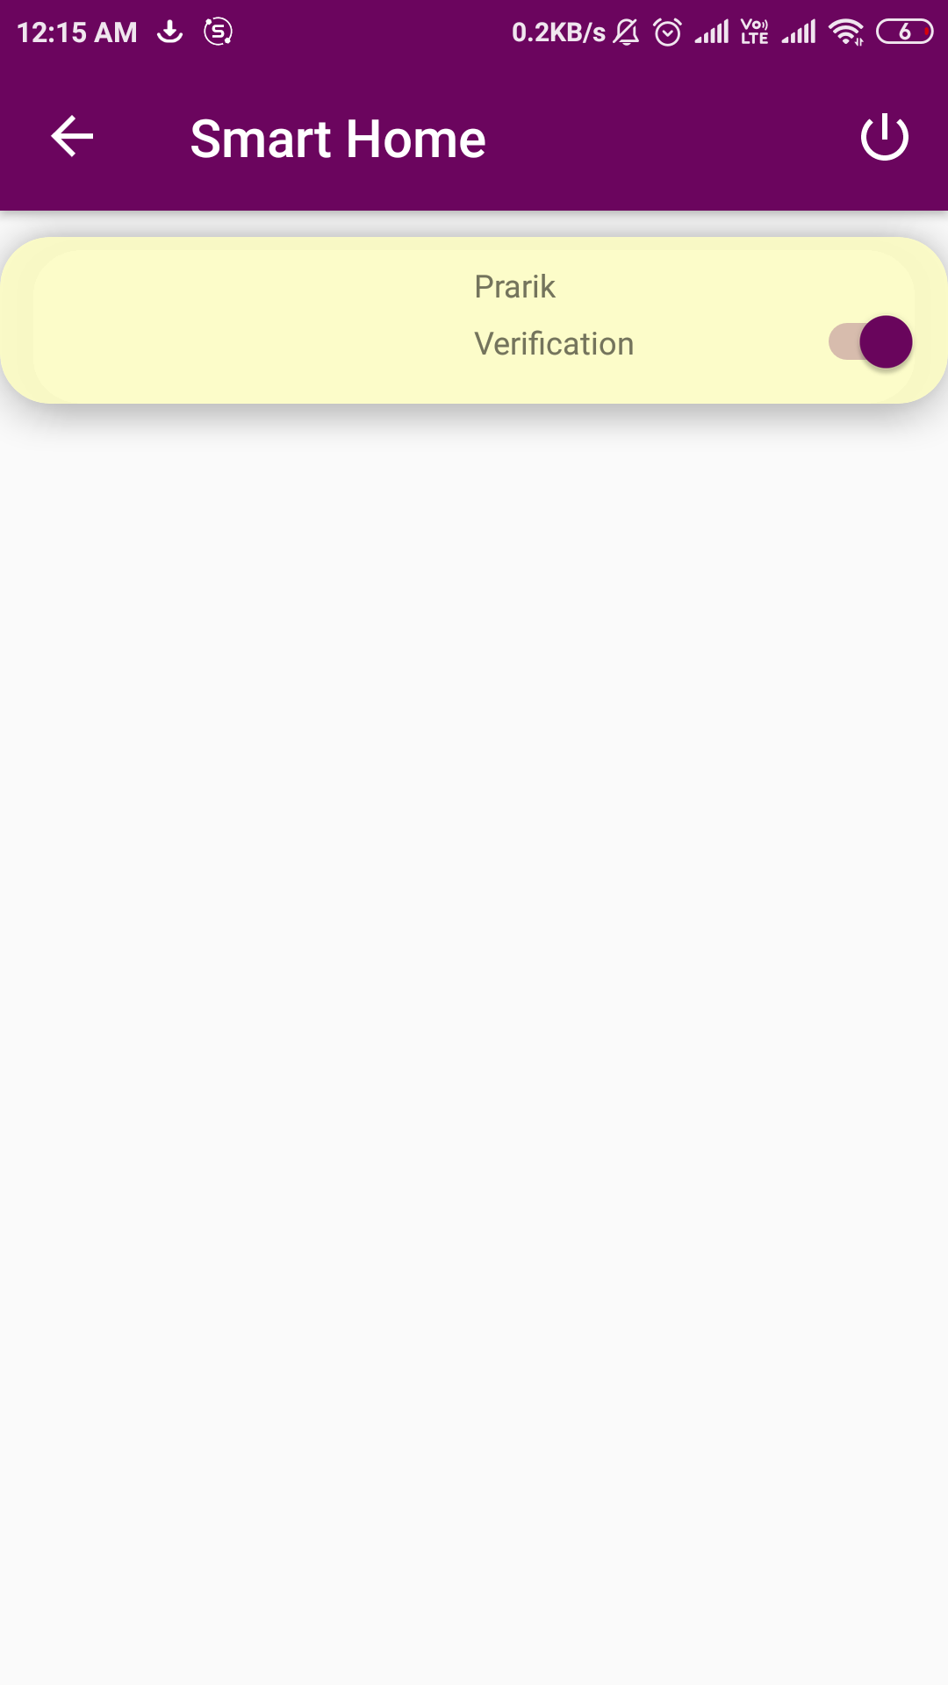
Set user permission
Admin can choose to allow or disallow a user.
Enable or disable the switch to allow or disallow the user.

Slide 18
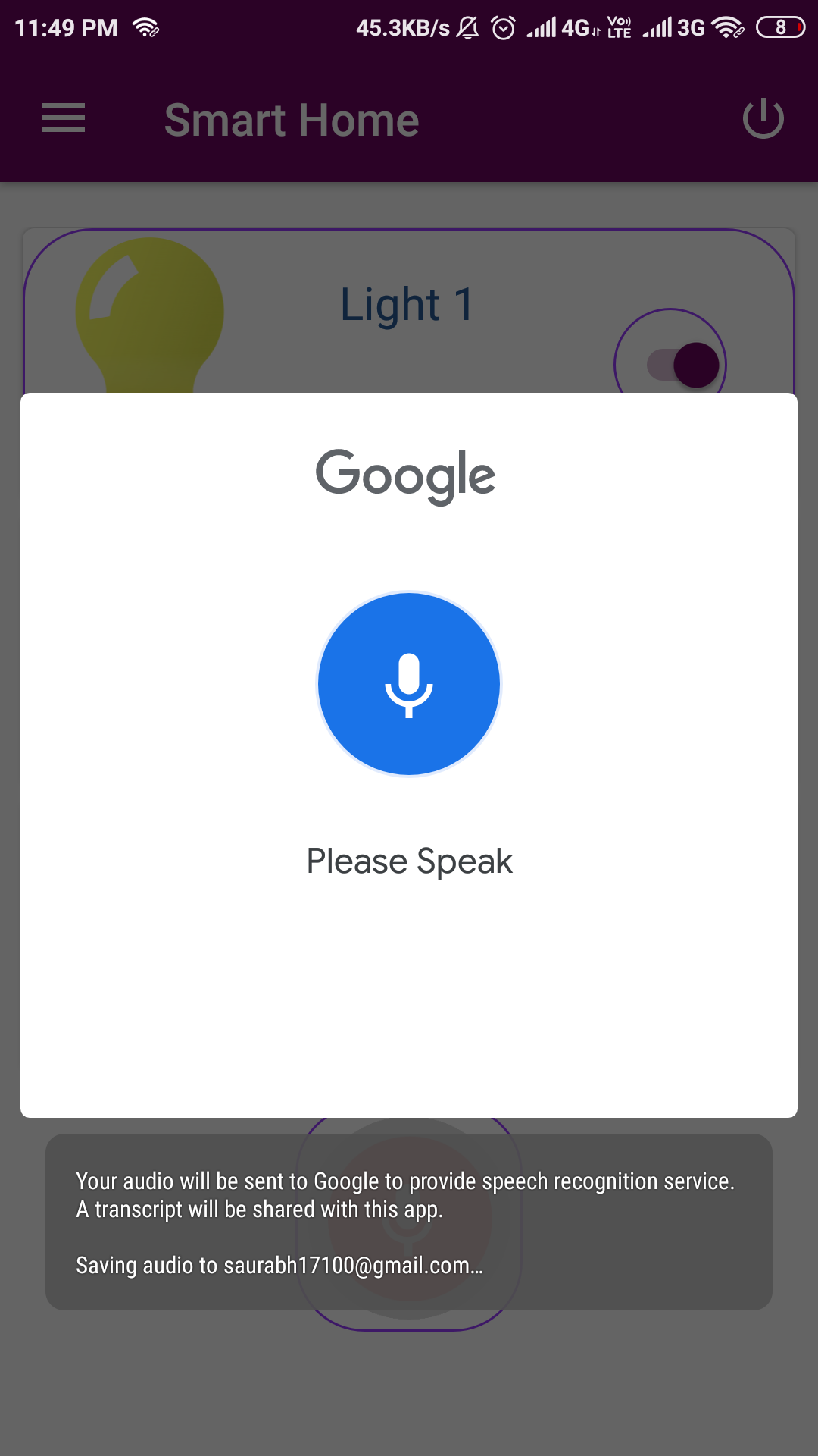
Just command your home
Tap on the mic icon and speak out command.
For example- “Switch on the lights”
Google Assistant used for voice recognition.

Slide 19

The WEB app
Phone discharged !!
No Problem….We got your back
The user can access and control the appliances using the website also.

Slide 20
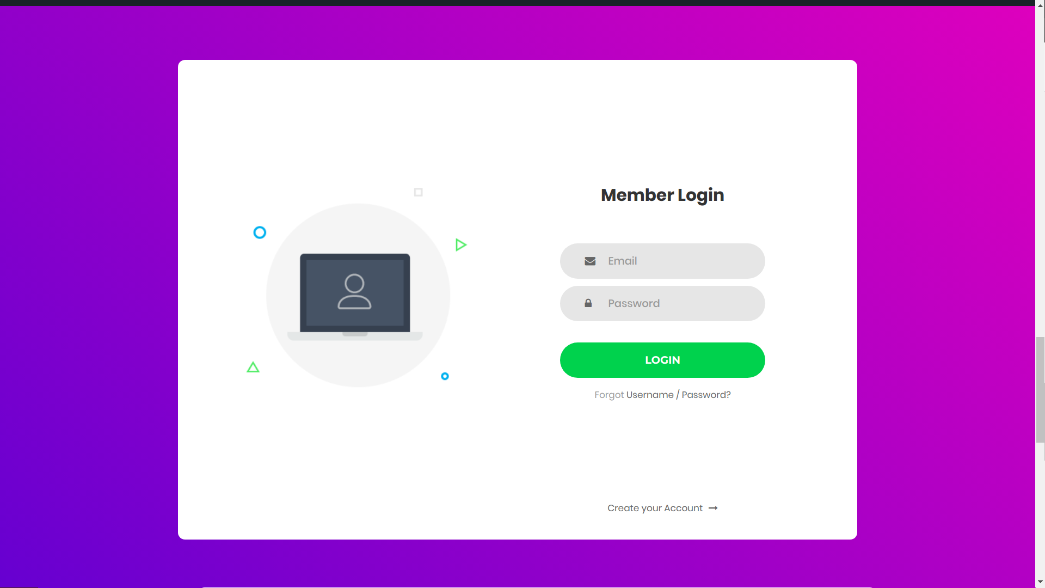
Login using your account credentials
Enter you email and password.
Just tap on the login button.

Slide 21
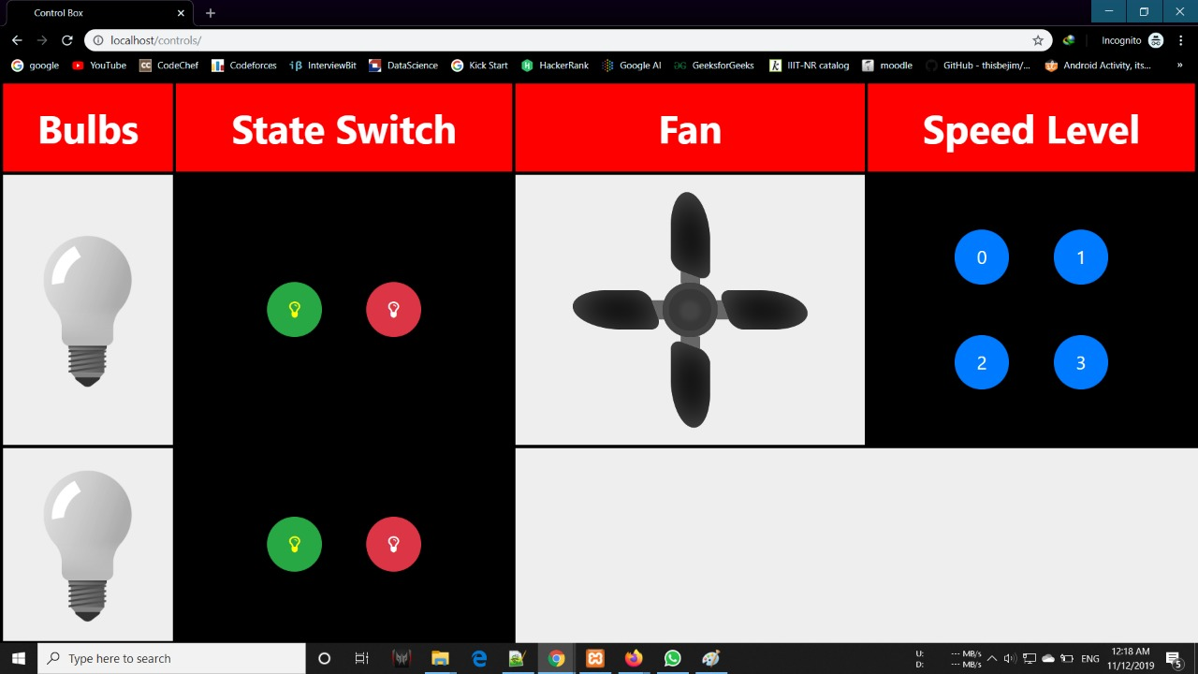
2. Control appliances seamlessly
Similar to android app,
Functionality is achieved using javascript and firebase.

Slide 22
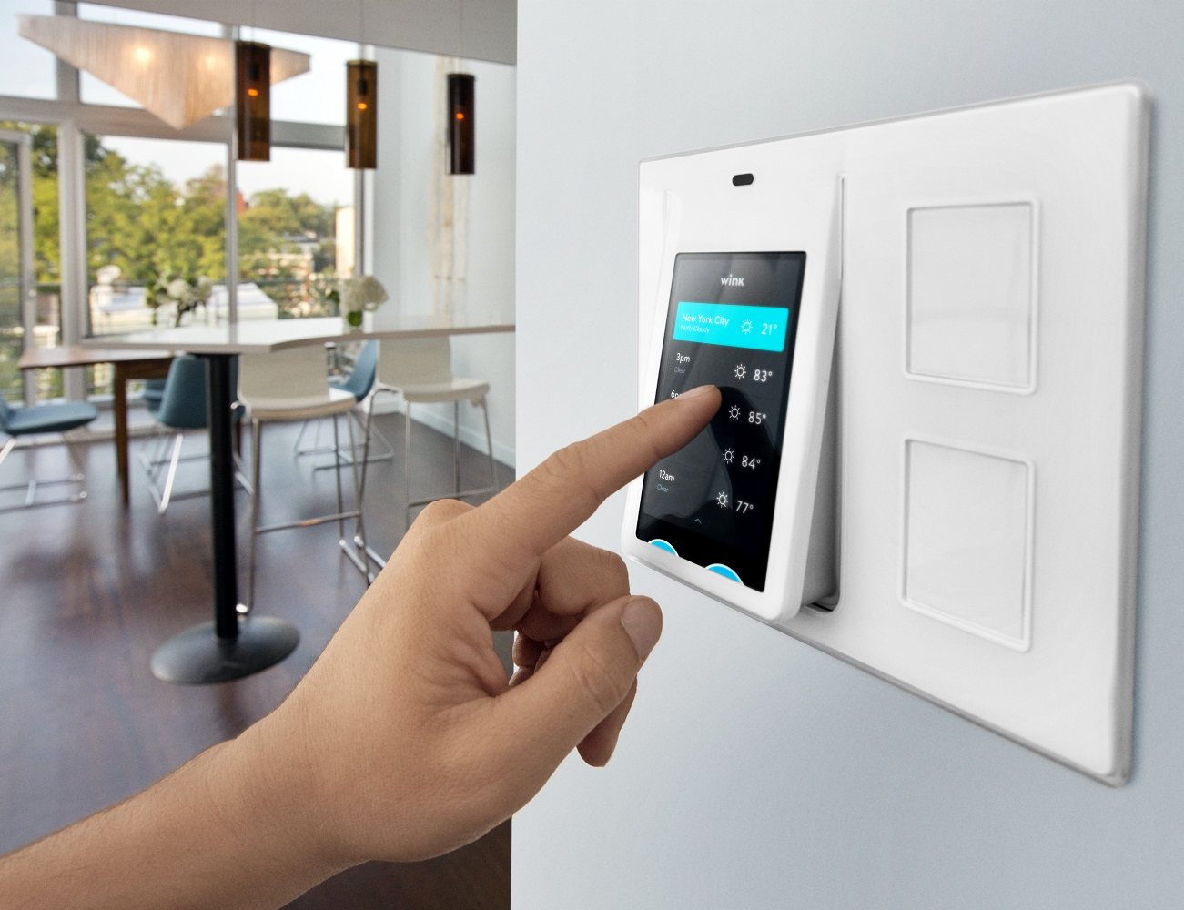
Manual Dashboard
Oops No Internet !!
Don’t worry we are here...
The system is equipped with the manual switch.
If back online, the system data will automatically updated in our database.

Slide 23
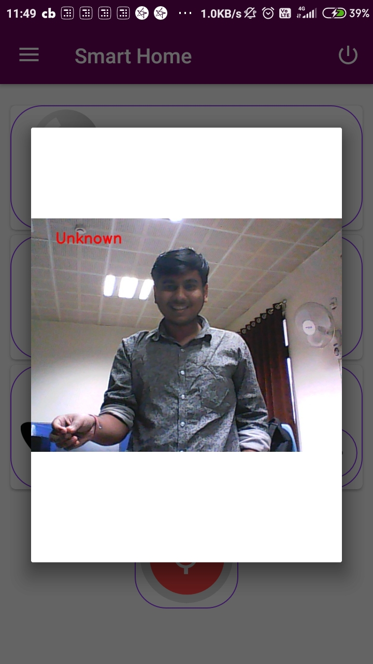
Home Surveillance
Get alerted on seeing unknowns
You get a popup on your android as soon as an stranger is detected.
Intruder spotted!

Slide 24
Application
Convenience for specially abled and old age people
Monitoring kids who are at home possibly alone or with babysitters/relatives.
Industrial surveillance
Alert System
Patients care system

Slide 25
Conclusion
IoT conceptualizes the idea of remotely connecting and monitoring real world objects through the Internet.
When it comes to our house, this concept can be aptly incorporated to make it smarter, safer and automated. Using this system, we can turn on or off appliances
It is integrated with Intruder detection (using facial recognition), and
Manual controlling for backup.

Slide 26
What next?
Functionality to add more appliances.
Guest Interaction System.
Door Locking System.
Option to add multiple houses.

Slide 27
Thankyou !!

